Slide 1
Ecosystem service and natural capital accounting approach

Slide 2
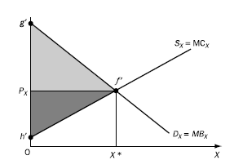
Economic theory (1)
Allocative efficiency: every good or service is produced up to the point where the last unit provides a marginal benefit to consumers equal to the marginal cost of producing
An efficient market equilibrium is reached.
It is impossible to make one person better off except by making some other person worse off.
Note: Efficient != equitable
Notes:
Why the system of the free market?
1. The great attaction of free markets is that they do not require any institution or agent to organise the market. (voluntary transaction)
2. The market is decentralized in contrast to a centralized planned economy. Agents are profit and utility maximizing and rational.

Slide 3
Economic theory (2):
Markets achieve allocative efficiency given that certain conditions are met, such as:
A market exists for all goods and services
All markets are perfectly competitive
All transactors have perfect information
Many buyers and sellers (price takers)
Free market entry and exit
No externalities
More…
Notes:
It can be shown that given certain rather stringent conditions, an economy organised as a competititive market economy can attain a state of economic efficiency.
Where conditions do not hold, markets do not attain economic efficiency in allocation, and a state of “market failure” is said to exist.
Economists use welfare economics to identify ‘market failures’ – situations where actual circumstances depart from the ideal – and to recommend policies to correct them so that actual economies perform better in relation to the objective of efficiency.

Slide 4
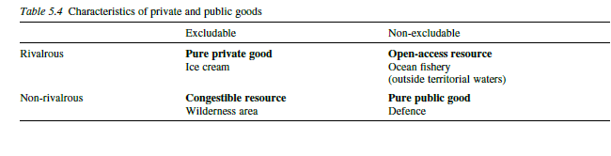
Market failure
One manifestation of market failure is the phenomenon of ‘externalities’.
External effects often relate to so-called non-exclusive and / or non-rival goods and services.
All of the goods except private goods can lead to free riding, overexploitation or degradation.
Notes:
Markets are usually a good way to organize economic activity
every single economic transaction in the world is based on incorrect information
By far the largest example of such a failure is that market prices fail to take environmental costs into account.
Open access common property= fishing, medicinal plants = decreasing stock future gen.
Club goods = windows 10 = marginal cost 0 = undersupply.
Public goods = Typical examples of public goods include clean air, soil water storage that yields flood control, and beautiful views over a landscape= non priced benefits
Congestible resources = wilderness area, recreation

Slide 5

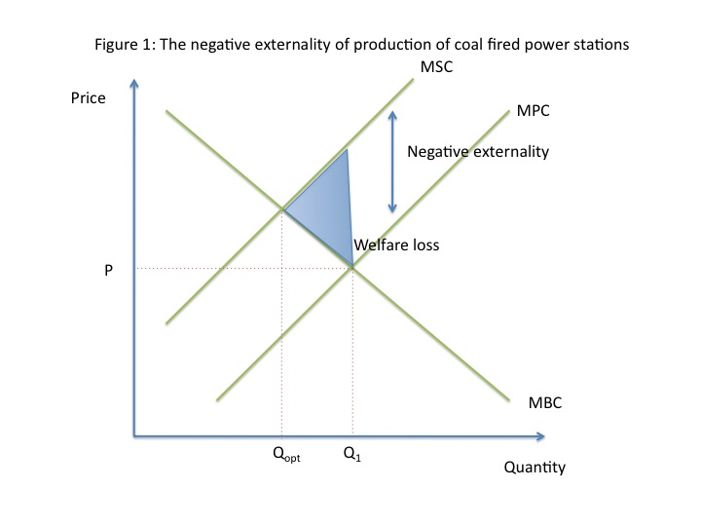
Externalities & missing markets
The coal fired power station:
Energy production provides us with benefits, but…
Air pollution
Carbon emissions
Competitive firms and consumers do not have to pay for the harms of their negative externalities, so they create excessive amounts.
No market for air pollution…
Overuse or under-provision
Notes:
Externality = price equilibrium cannot reflect the true costs and benefits of that product or service.^{[2]} This causes the externality competitive equilibrium to not be a Pareto optimality.
lack of reward/punishment, which in a market system would be signalled
Open access common property= fishing = decreasing stock future gen.
Club goods = windows 10 = marginal cost 0 = undersupply.
Public goods = clean air = non priced benefits

Slide 6
Solving for externalities: The Coase theorem
Externalities arise because property rights are not clearly defined.
Allocating property rights to either of two parties results in an efficient outcome if the parties can bargain.
Lets try it…
High transaction costs
strategic bargaining behaviour
Either side lacks information about the costs or benefits of reducing pollution
Therefore…complex external effects lead to missing markets!

Slide 7
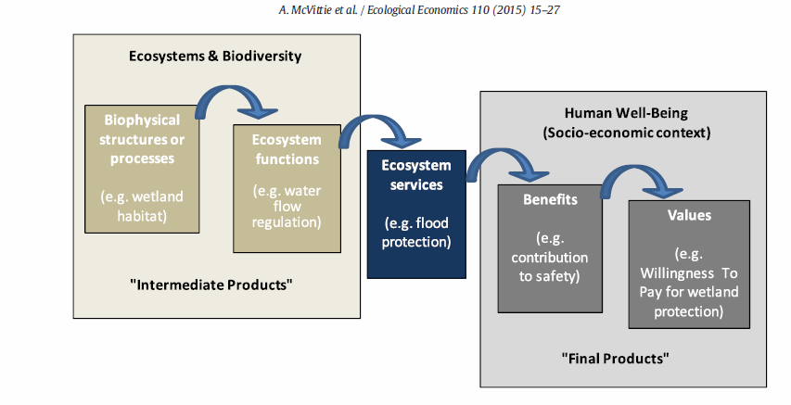
ES services framework
Much of environmental economics is about the identification and correction markets failures in relation to the services that the environment provides to the economy.
Notes:
Information about ES provided by KBAs, WHS and PAs can be useful for many reasons, including increasing support for safeguarding the multiple benefits provided by sites, informing management decisions, ensuring equity in resource use and benefits sharing, and enabling evaluation of the consequences of management or policy changes on ES provided by the sites

Slide 8
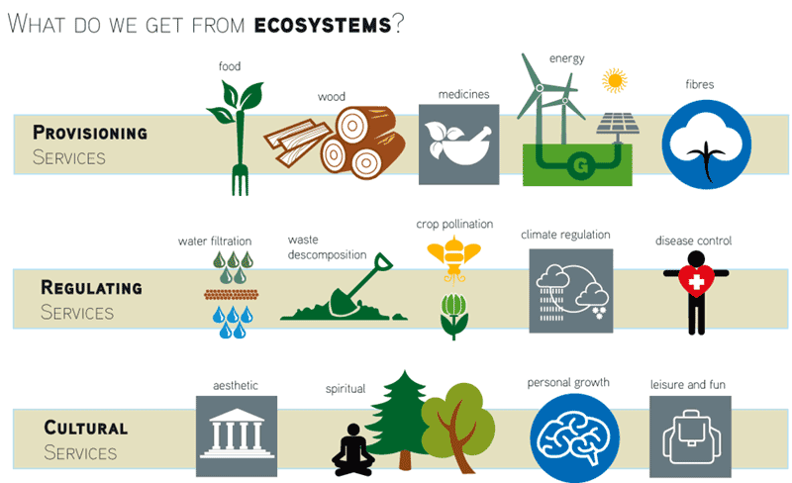
Ecosystem services (ES)
“The benefits people obtain from the use of a good- or a service provided by ecosystems”

Slide 10
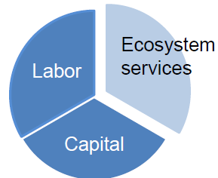
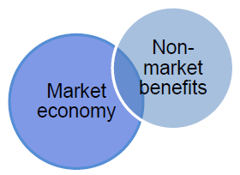
Why value nature / ES?
Value or price?
Correcting for market distortions/failure:
ES have public good/ common property characteristics
ES are affected by externalities
ES have unclear property rights
Concluding:
Make explicit the link between ecology and human-wellbeing
Make non-marketed benefits visible
Notes:
Value or price?
Consider a walk in a local park. Market=0, no entrance fees and anyone can simply walk in.
However, the very fact that people do indeed spend their valuable time in parks shows that this is not a zero value good.
It is clear to see that ‘value’ and ‘price’ are not necessarily the same thing. → recreational ES service
Correcting for market distortions
So why do we not see the value of these Ecosystem service goods reflected in our decision-making? → market failure.
Let us consider the example of water quality in a river:
Public goods
The problem with public goods is that, although people value them for drinking or recreation, no one person has an incentive to pay to maintain the good.
This brings us to the next two bullet points.
Externalities
Some third party like a factory or farmers can pollute the river, which affects the people downstream. The problem is that while people downstream are negatively affected, the environmental damage is not compensated.
Property rights
This brings us to the last problem of property rights: nobody really “owns” the resource and therefore the natural resource might be overused.
Market failure of ES that are public good→ therefore: quantify, monetize…
as an important policy tool to cope with scarce resource allocation in a sustainable way.
Concluding
The economist is then there to… link ecology, well-being → market economy
Non-marketed benefits → by estimate the value of many environmental goods and services in terms of the welfare they generate

Slide 11
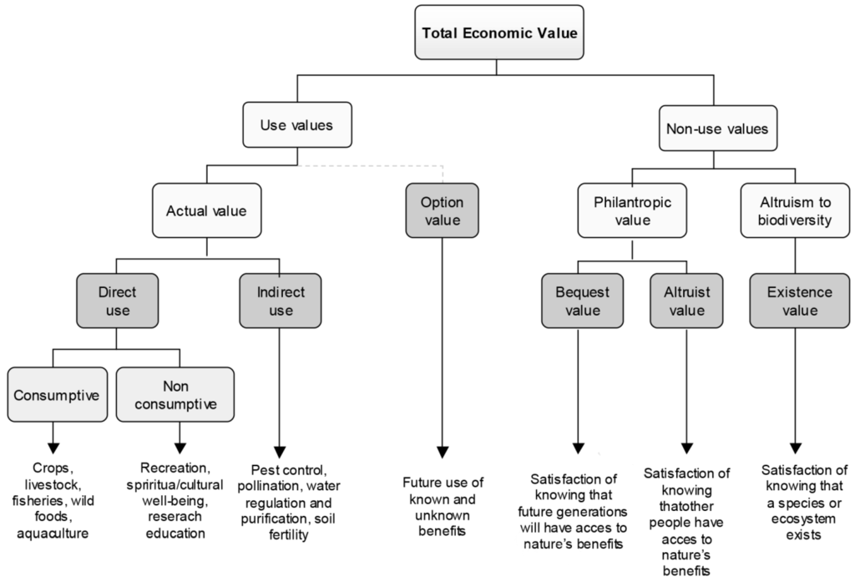
Total economic value framework (TEV)
The value of natural resources is often considered within the framework of Total Economic Value (TEV), and this framework can be used to value ecosystem services.
Notes:
Information about ES provided by KBAs, WHS and PAs can be useful for many reasons, including increasing support for safeguarding the multiple benefits provided by sites, informing management decisions, ensuring equity in resource use and benefits sharing, and enabling evaluation of the consequences of management or policy changes on ES provided by the sites

Slide 12
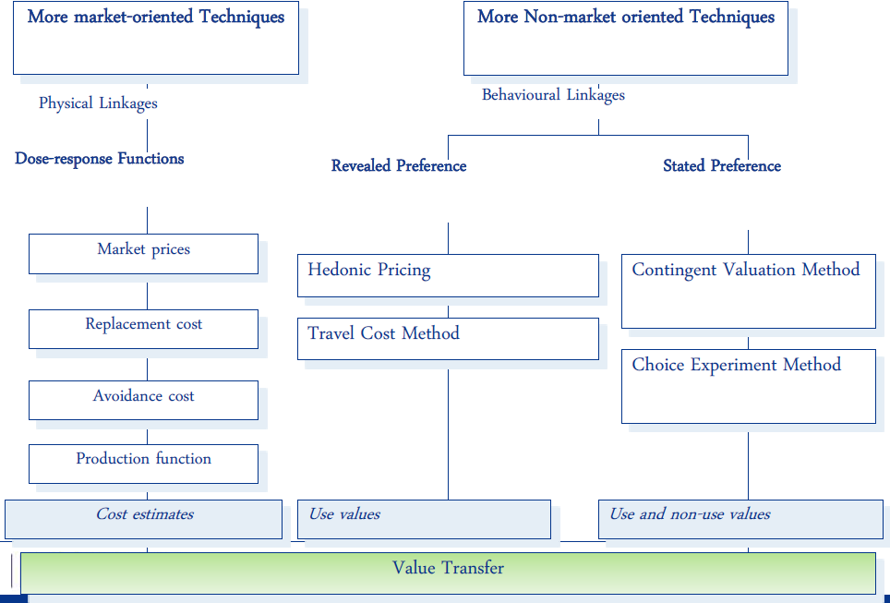
Valuation approaches
Notes:
Benefit transfer: using valuation data from one case-study and use it in another.

Slide 13
Revealed preferences: Hedonic pricing method
Link to the video

Slide 15
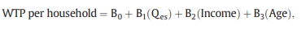
Benefit transfers
Transferring an average WTP estimate from one primary study
Previously conducted, sound study quantifying WTP and adjust the estimate for inflation.
Transferring a WTP function
Estimated in which WTP depends on the quantity or quality of the ecosystem service provided and socioeconomic characteristics of the population originally surveyed.
Transferring WTP estimates from meta-analyses.
Notes:
Benefits transfer is a process by which the economic values that have been generated in one context – the ‘study site’ – are applied to another context – the ‘policy site’

Slide 16
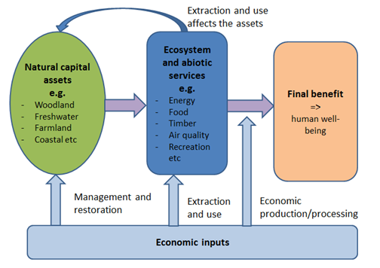
What is natural capital accounting?
Stock/asset account:
Quality and quantity of assets
Physical flow account
Monetary flow account
Notes:
So I have now explained what ecosystem services are and why it is necessary to value ES. I will now move on to the link between ES valuation and NCA.
In a standard accounting framework human capital, manufactured capital and financial capital are routinely considered in financial and management decisions.
Click
In essence, NCA is the application of ecosystem valuation by setting up a series of interconnected accounts that provide a structured set of information relating to the stocks of natural capital and flows of services supplied by them.
Stock/asset account: record assets at the start and end of the calendar year
Assets creates physical flows
These can be monetized

Slide 17
Why do we need Natural Capital Accounting?
Monitor losses and gains in our natural capital over time
Identify priority areas for investment and inform resourcing and management decisions
Highlight links with economic activity and pressures on natural capital
Notes:
Monitor losses + identify priority
ES recognized as a form of capital, and the accounts allow tracking changes in ecosystem assets over time
This includes the monitoring and tracking of natural capital degradation or enhancement, thus supporting analysis of sustainable development.
Highlight link
Again just as we said before:
The aim is to ensure that we maintain not only the flow of benefits (ecosystem services) that the environment provides but also its capacity to yield these benefits (i.e. natural capital stocks).

Slide 18
Application of NCA and ES
Eftec (Economics for the environment), consultancy firm in London.
Ian Dickie, eftec envecon 2018.
Centre for Ecology and Hydrology
Laurence Jones, Centre for Ecology and Hydrology (CEH)

Slide 19
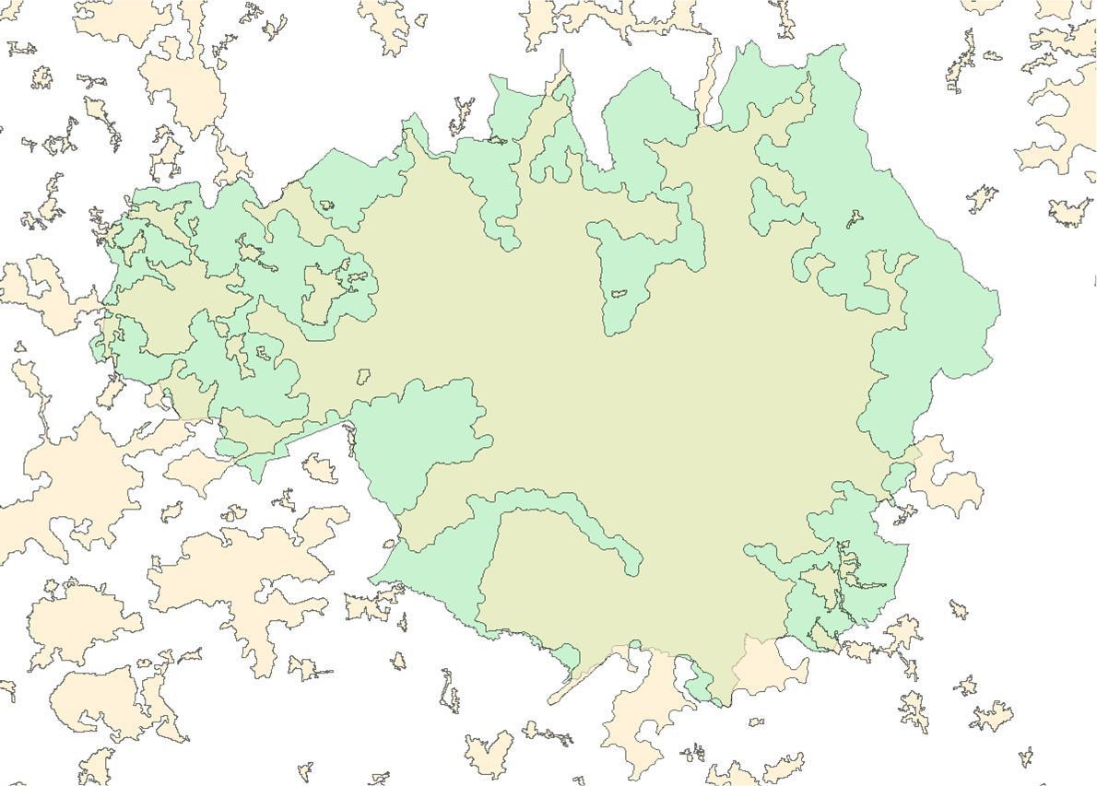


MANCHESTER URBAN NATURAL CAPITAL ACCOUNT - Scope
Urban extent polygons
Boundary of GMCA

Slide 20
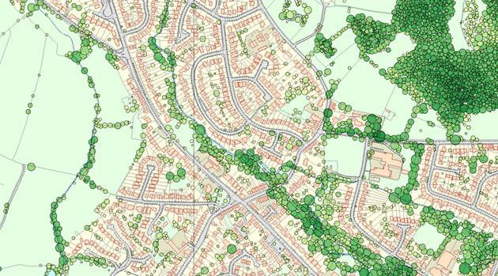
MANCHESTER URBAN NCA - Noise
i) Identify patches of tree cover greater than a threshold area of 200 m² (using Bluesky National Tree Map) on the assumption that these provide a 2dB noise mitigation service

Slide 21
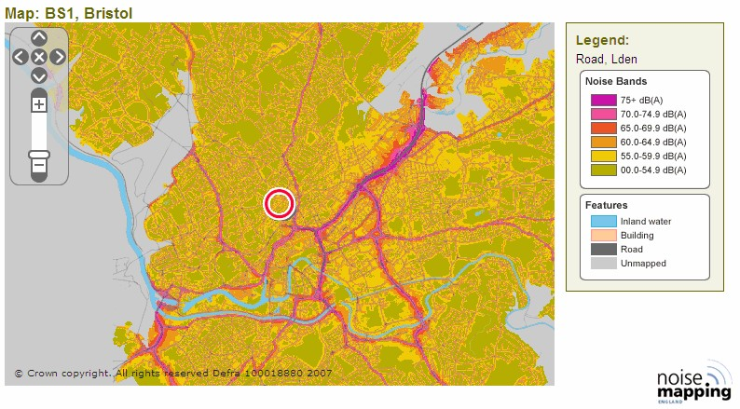
MANCHESTER URBAN NCA – Noise
i) Identify patches of tree cover greater than a threshold area of 200 m² (using Bluesky National Tree Map) on the assumption that these provide a 2dB noise mitigation service
ii) Calculate the urban areas potentially affected by those trees using spatial noise maps for road noise (Defra, 2014)

Slide 22
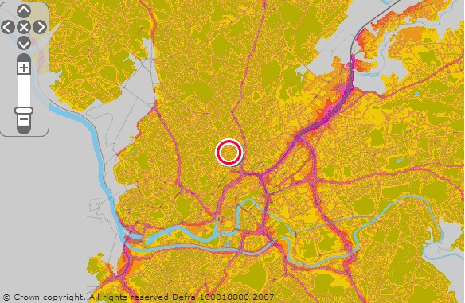
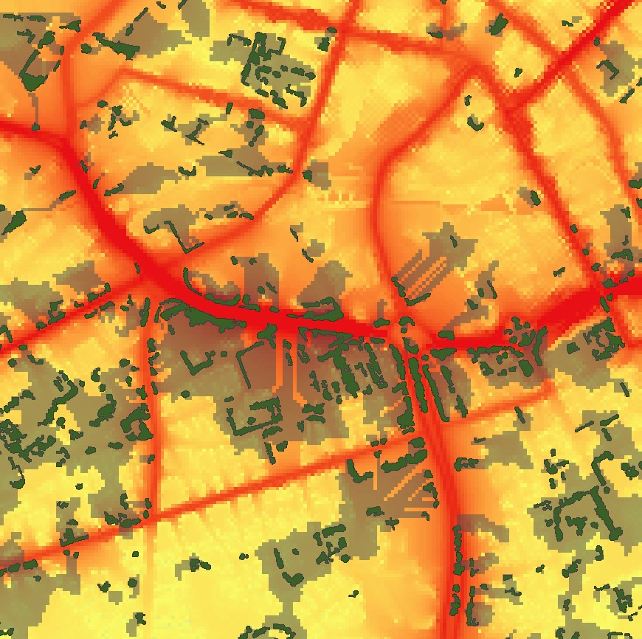
MANCHESTER URBAN NCA - Approach
Heat map shows:
- Areas where noise level is reduced due to tree presence (grey)
- Road noise (yellow – low; red - high)
- Trees greater than 200 m² canopy (green)

Slide 23
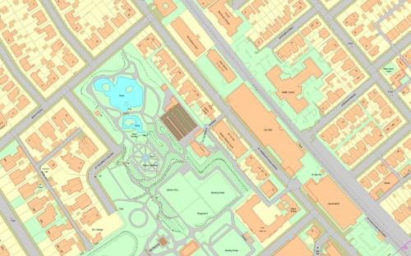
MANCHESTER URBAN NCA - Noise
Identify patches of tree cover greater than a threshold area of 200 m² (using Bluesky National Tree Map) on the assumption that these provide a 2dB noise mitigation service
Calculate the urban areas potentially affected by those trees using spatial noise maps for road noise
Identify the location of beneficiaries in those zones using building from OS Mastermap

Slide 24
MANCHESTER URBAN NCA – Physical units
Natural capital benefit | Indicator |  | Amount (2016/2017) | Units
Noise regulation | Noise band (dBA): |  |  | Number of buildings mitigated by 2dBA
 |  | >=80 | -
 |  | 75.0-79.9 | 1,000
 |  | 70.0-74.9 | 11,000
 |  | 65.0-69.9 | 45,000
 |  | 60.0-64.9 | 107,000
 |  | 55.0-59.9 | 264,000
 |  | 50.0-54.9 | -
 |  | 45.0-49.9 | -
 | Total |  | 428,000
Global climate regulation | Carbon (equivalent) sequestered |  | 25,000 | Tonnes of CO₂e per year
Local climate regulation | Combined cooling effect of urban parks and woodland (all patches) |  | 0.50 | Degrees Celsius
Physical health benefits | QALYs per year |  | 3,000 | QALYs per year
 | Active visitors |  | 84,000 | Number per year

Slide 25
MANCHESTER URBAN NCA - Monetary results
Avoided direct & indirect costs to society
£38m
Physical health benefits
Welfare gain (based on increased QALYs)
£63m
Local climate regulation
£2m
Market values - avoided loss in GVA, avoided air-conditioning cost
Noise mitigation
Welfare gain (based on avoided loss of QALYs – amenity and health)
£59m
Carbon sequestration
£2m
Non-traded price of carbon
-
10
20
30
40
50
60
70
Annual value (£m per year)

Slide 26
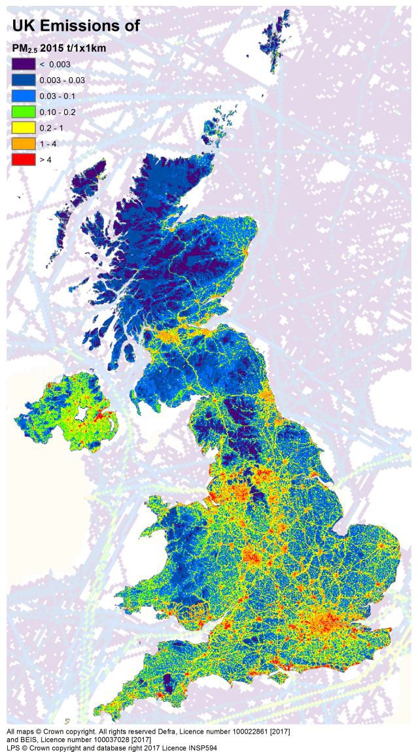
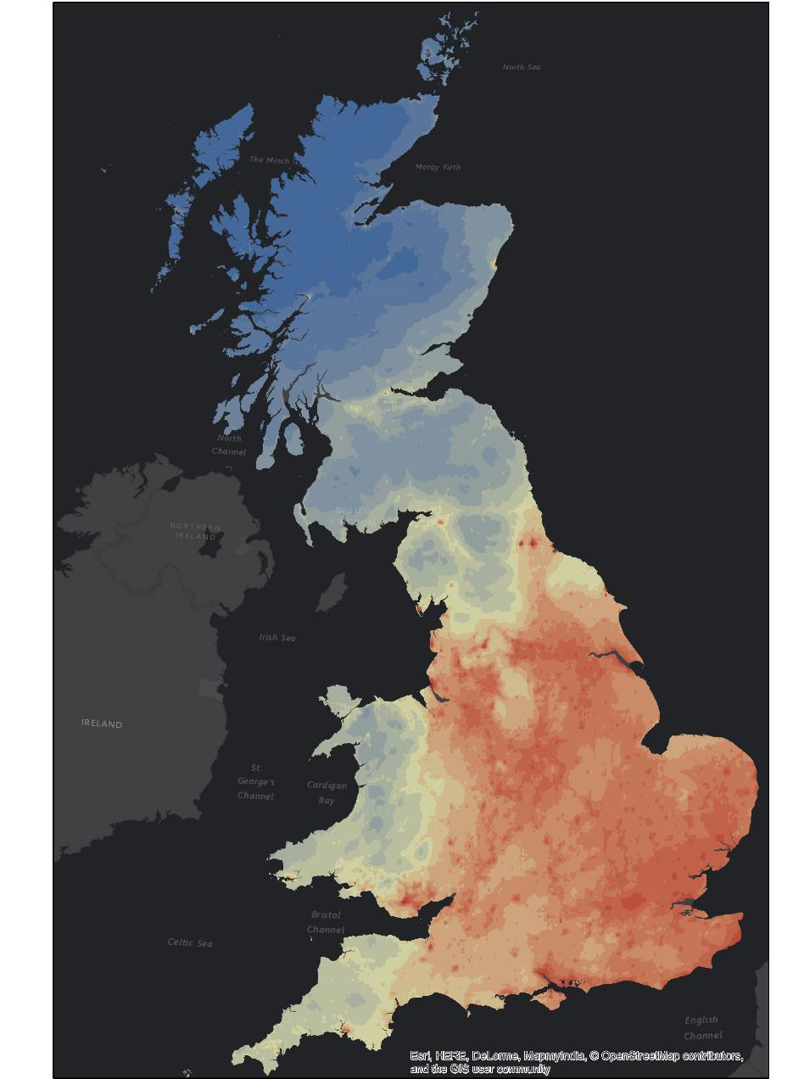
Atmospheric chemistry modelling
5
Physical account
Chemical interactions at 5 km x 5 km
(~1.5 x 2km also possible)
Vegetation cover at 25 metre resoluti
Hourly time step
Generates concentrations from emissions, including chemical & meteorological interaction & Atmospheric transport
Five pollutants of interest: (PM_{2.5}, SO₂, NH₃, NO₂, O₃)
UK NAEI
on
ns
2015, concentrations of PM_{2.5}

Slide 27
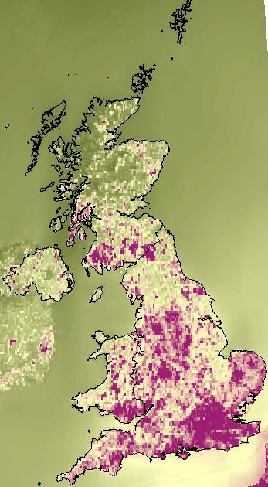
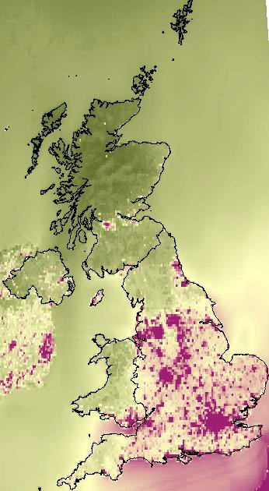
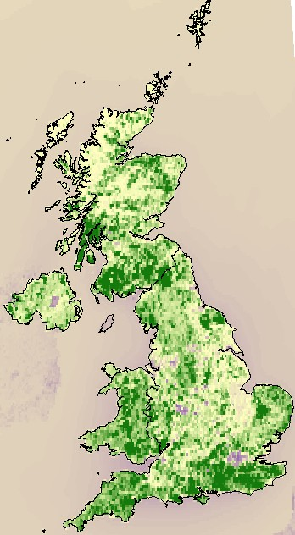
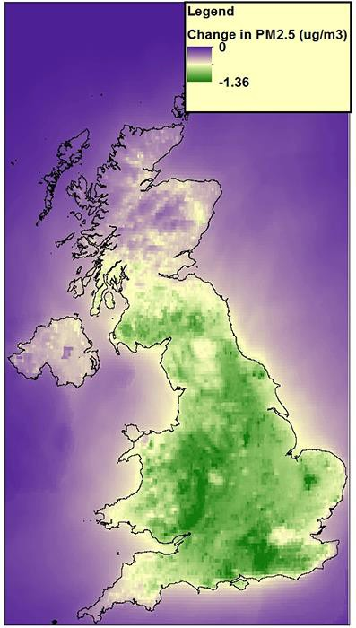
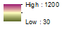

EMEP outputs – national run, all vegetation
6
Change in exposure to PM_{2.5} (µg/m )
Avg: -0.55 (-10%)
Quantity of PM_{2.5} removed (mg/m²)
3
Base map, 2015
No vegetation scenario
Difference map

Slide 28
Physical account- national scale
7
Quantities of pollutant removed (kt/yr)
 |  | Habitat | Coniferous woodland | Deciduous woodland | Semi-natural (grassland, moorland) | Crops | Total vegetation
 |  | Area CEH landcover (km²) | 15,361 | 13,950 | 135,909 | 63,161 | 228,381
 |  | PM₁₀ | 21.3 | 14 | 7.7 | 0 | 43
 |  | PM2.5 | 9.6 | 8.2 | 4.5 | -0.1 | 22.2
 |  | SO₂ | 4 | 7.1 | 17.7 | 9.5 | 38.3
 |  | NH₃ | 4.7 | 8.4 | 26.5 | 7.8 | 47.4
 |  | NO₂ | 1.6 | 2.6 | 10.4 | 9.1 | 23.7
 |  | O₃ | 121.6 | 95.5 | 597.1 | 383.9 | 1198.2

Slide 29
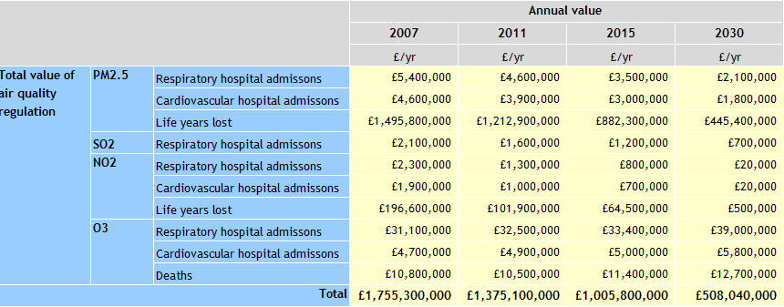
Monetary account - national
8
Annual value of health benefits
8

Slide 30
Management implications: Payment for Ecosystem Services (PES)
(a) a voluntary transaction where
(b) a well-defined environmental service (or a land use likely to secure that service)
(c) is being ‘bought’ by a (minimum one) service buyer
(d) from a (minimum one) service provider
(e) if and only if the service provider secures service provision (conditionality).
Notes:
Common policy instruments for influencing businesses decision-making is through Cap-n-trade, command and control, tax: politically infeasible and costly to implement
Forcing businesses to provide certain ES means that you essentially require them to pay for the provision of ecosystem services for the benefit of the entire public.
→ (PES) voluntary transactions…

Slide 31
What is needed for PES?
Link between land use and benefits
“Why should we pay for a certain land management plan?”
Identification of service providers and beneficiaries for PES on different spatial scales
Who actually benefits from a certain payment scheme?
Build a case for investment in ES management
Economic analysis needs to be done to justify potential improvements to investors.
Notes:
All in all, a NCA builds a case for PES:…
NCA provided indicators for measuring ES on the Estate and identified to some extent how much of the ES are supplied by current management practises. educate the surrounding community
Made clear in report who benefits from ES to accurately target them for payment programmes.
Service providers: Estate, farmers on Estate, farmers outside Estate. Arable private good → incentive to provide
ES public good → no incentive. Benefits on different scale, costs local scale. (carbon sequestration).
valuation helps to increase awareness of (economic) benefits that the ES of the Estate provide to people and help build support among local stakeholders and politicians for establishing PES

Slide 32
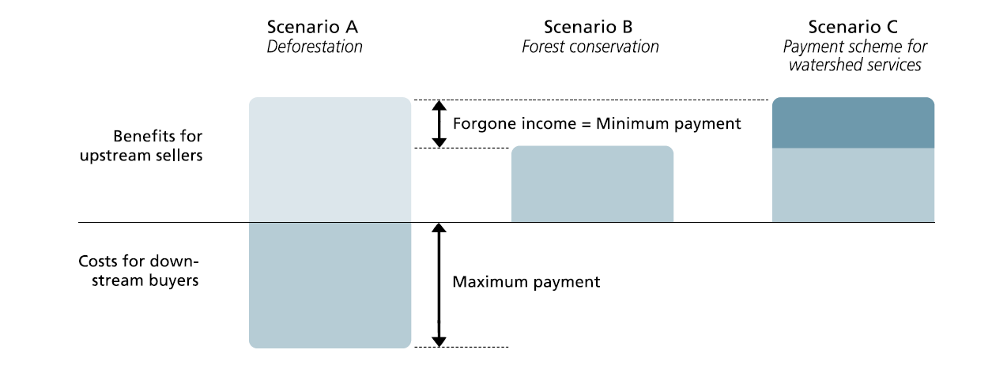
PES example
“A deal is possible, where the willingness to pay of buyers is higher than the minimum payment accepted by sellers.”
Making privately unprofitable but socially-desirable practices become profitable to individual land users.
Notes:
The goal of PES programs is to make privately unprofitable but socially-desirable practices become profitable to individual land users (Engel, 2008).
Social inefficiency:
Offering payments that are insufficient to induce adoption of socially-desirable land uses, thus causing socially-undesirable land uses to remain in use
Inducing the adoption of socially-undesirable land uses, that supply environmental services, but at a cost higher than the value of the services.

Slide 33
Governance challenges of creating a payment scheme
User-financed or government financed
Free-rider behaviour
Transaction costs
Other considerations
Who should take part in negotiations?
Input based payments
Additionality
Resilience
Bundling of ES

Slide 34
Conclusion
NCA provides a way for land managers to keep track of the quality and quantity of natural capital assets which provide ecosystem services.
Limitations in availability of biophysical- and economic data are present, making concrete NCA supported decision-making somewhat difficult in practise.
Nonetheless, NCA provides the tools to make ES providers and ES suppliers more aware of how ecosystem provide benefits to society in spite of the limitations. It could therefore be used as the basis for PES.

